Slide 1
Trench Warfare in WWI
Year 9 History

Slide 2
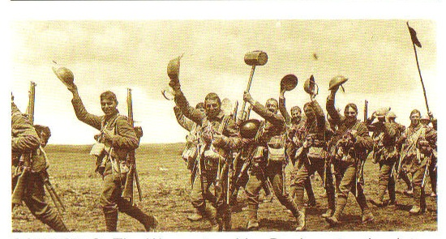
Myth

Slide 3
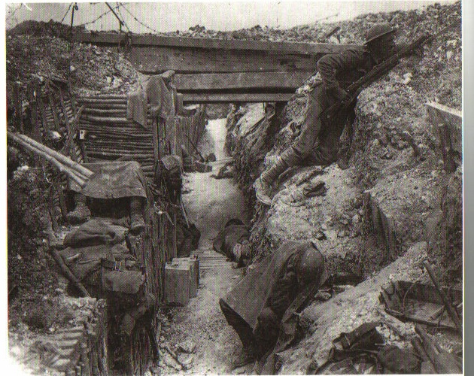
Reality

Slide 4
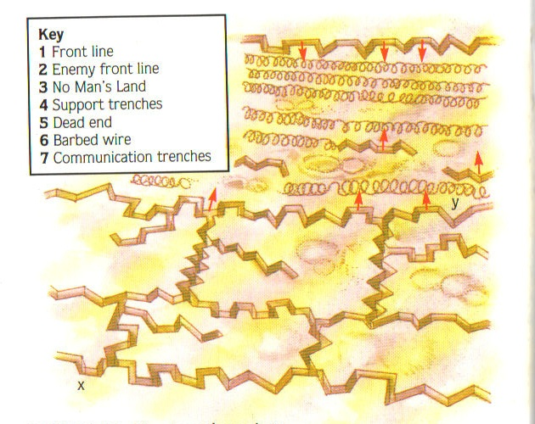
The Trench System
Front line
Communication trench
Support trenches
No Mans Land
Barbed wire

Slide 5
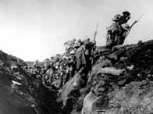
Trench Warfare
Offensive attacks into No Mans Land
Shell fire
Going over the top
Retreat
The enemy goes forth

Slide 6
Suggested Tasks
Draw a picture of a trench see p. 24 of textbook.
Write a description how trench warfare worked.
Draw a picture of a soldier and what he would have had to take into battle.
Resources: Textbook p.22-31
Trench warfare packs

Slide 7
This powerpoint was kindly donated to www.worldofteaching.com
http://www.worldofteaching.com is home to over a thousand powerpoints submitted by teachers. This is a completely free site and requires no registration. Please visit and I hope it will help in your teaching.

